Slide 1
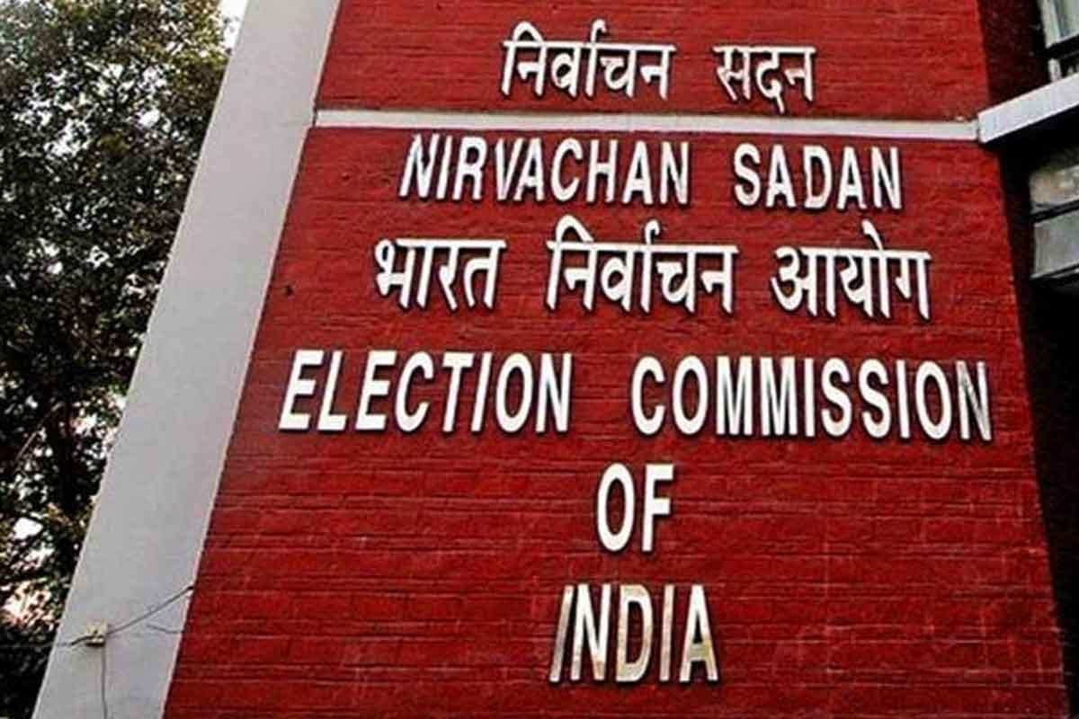
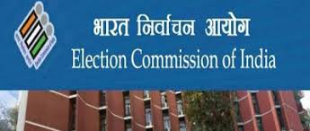
ELECTORAL POLITICS

Slide 2
Chapter:- Electoral politics
Now let us discuss the chapter ELECTORAL POLITICS
We already know what is politics, so let us study about electoral politics-
It is a field where we elect our representatives by voting them. The more the votes, the more the chances to win the election.

Slide 3
Elections can lead to changes in the policy of government.
The governor invited can become the chief minister if he is impressed by the speeches.
People are unhappy with every ruling party and vote against it in the next election.
The party that wins the election forms the govt.
The election can lead to economic development in the state or in the country.

Slide 4
The party need not have not resigned after his party lost elections.
The country which have elections are said to be democratic.

Slide 5
The people can choose their leaders who will make laws for them.
They can choose who will form the government and take major decisions.
They can choose the party whose policies will guide the government and law making.
A rule of the people is possible without any elections if all the people cab sit together everyday and take all the decisions.

Slide 6
People can choose their representatives at regular intervals and change them if they wish to do so.
Therefore, elections are considered essential in our times for any representative democracy.

Slide 7
Everyone should be able to choose. This means that everyone should have on vote and every vote should have equal value.
There should be something to choose from. Parties and candidates should be free to contest elections and should offer some real choice to the voters.

Slide 8
The choice should be offered at regular intervals. Elections must be held regularly after every five years.
The candidate preferred by the people should get elected.
Elections should be conducted in a free and fair manner where people can choose as they really wish.

Slide 9
It can be divided into two parts demerits and merits
Clearly, an electoral competition has many demerits.
It creates a sense of disunity and factionalism in every day society.

Slide 10
Candidates and parties use dirty methods for winning elections.
People who want to serve the country avoid entering this field owing to unhealthy competition.

Slide 11
People will get the full right to vote and choose their representatives.
The country which has adopted the election procedure is also counted in democratic country.
It helps to the elected representative to go out and serve the country and the countrymen.
After the people get the right to vote they are considered as equal .
The following picture shows the countries who have adopted democracy and has benefitted.

Slide 13
•
The Lok Sabha and the Vidhan Sabha elections are held in India every 5 years.
The Lok Sabha election is called the General Election.
There are certain elections that are conducted in a particular constituency owing to the death/ resignation of a member. These are called by- elections

Slide 15
The country is divided into electoral constituencies for both the Lok Sabha and the Legislative Assembly elections. One representative is elected from each constituency by the voters.
The country is divided into 543 constituencies for the Lok Sabha elections. The selected representative is called the Member of Parliament or MP.
Similarly, each state is divided into a number of Assembly constituencies and the representative elected from each constituency is called the Member of Legislative Assembly or MLA.

Slide 16
For lok sabha elections, the country is divided into 543 constituencies. The representative elected from each constituency is called a member of parliament or an MP.

Slide 17
In open electoral competitions, certain weaker sections of the society may not stand a good chance of winning because of the influence of powerful sections
Hence, the makers of our Constitution prepared a system of reserved constituencies for these weaker sections.

Slide 18
Certain constituencies are reserved for the people belonging to the Scheduled Castes (SC) and the Scheduled Tribes (ST).
In the Lok Sabha, seats reserved for the SCs and STs are 84 and 47 respectively as on 1 September 2012.
These are in proportion to their population in the total population of the country.
They may not have the required resources - education and contacts to contest and win elections.

Slide 20
The list of people who are eligible for voting is prepared by the Election Commission of India.
This ensures that everyone in the country gets an equal opportunity of choosing their political representatives.
Regardless of a person‟s caste, creed, colour and gender, every citizen of and above 18 years of age is eligible to vote.
This is an important step, it is linked to the first condition of a democratic election: everyone should get an equal opportunity to choose their representatives.

Slide 21
Different citizens differ from one another in many ways : some are rich ,some are poor ;some are highly educated and some are not so educated and some not educated at all, but still they have the right to vote.

Slide 22
An Indian citizen, Age should be minimum 25 years.
There are restrictions on people with criminal records, but those are extreme cases.
The candidate has to fill a nomination form and give a security deposit.
Also, a legal declaration has to be made with details of pending criminal cases against the candidate, assets and liabilities of the candidate and the educational qualifications of the candidate.

Slide 23
Every candidate has to make legal declaration, giving his full details of:
Serious criminal cases pending against the candidate;
Details of the assets and the liabilities of the candidate and his/her family.
Education qualification of the candidate.
The above information should be made public so that the voters get an opportunity on the basis of the information to vote for the deserved.

Slide 25
Election campaigns in India takes place for two weeks, starting from the declaration of the final list of candidates contesting the elections and concluding 48 hours before the date of polling.
During this campaign, candidates reach out to the voters. Political leaders hold election meetings and rallies for informing the voters about their policies and persuading them to vote for them.
The main purpose of election is to give people chance to choose the representative ,the govt and policies they prefer.

Slide 26
Some successful slogans used during campaigns are “Garibi Hatao” (used by the Congress, led by Indira Gandhi, in the year 1971), “Save Democracy” (used by Janata party in 1977), “Land to the Tiller’ (used by The Left Front in West Bengal Assembly elections, 1977), etc.
In an election campaign no party or candidate can:
Bribe/threaten the voters.
Influence the voters in the name of religion.
Use government resources for campaigning.
Expend more than 25 lakhs for the Lok Sabha elections and 10 lakhs for the Assembly elections.

Slide 27
Hold election propaganda in places of worship.
Use government aircrafts and vehicles, government officials, etc.
On the announcement of elections, ministers cannot take policy decisions or start any big projects.

Slide 28
A person, with his name on the voter‟s list can go to a polling booth, get identified by the officials, get the mark on his finger, and caste the vote for the candidate of his choice.
Agents of the candidates are permitted to be seated inside the polling booths for ensuring that a fair voting takes place.
Electronic Voting Machines (EVMs) are used for casting votes instead of the ballot paper.

Slide 29
Counting of votes begin after few days of election.
The final stage of an election is the day when the voters cast their vote. That day is usually called the election day. Every person whose name is on the voters list can go to a nearby polling booth situated in a govt schools or offices.

Slide 30
In India, elections are conducted by the Election Commission (EC). It is an autonomous
body, independent of any governmental control.
The President of India appoints the Chief Election Commission (CEC). The CEC is neither answerable to the government nor to the President.
EC takes all decisions related to elections. It declares the election dates and also the results.

Slide 31
The EC has the power of punishing those candidates/parties who violate the Code of Conduct.
During elections, the EC sets guidelines for the government, so that government‟s powers are not misused for winning elections.

Slide 32
Voter turnout figures determine the extent of people‟s participation in the elections. Compared to North America and Europe where the turnout has declined over the last 50 years, the figures for India either stayed stable or increased.
Compared to the USA where the richer and the white people vote the most, in India the majority of the voters are the poor, underprivileged and the illiterate people.

Slide 34
If elections are not free/fair, it favours the powerful/ruling party. Ruling parties lose elections in India routinely, both in the states and the national level.
Half of the sitting MPs and MLAs lose elections in India. This shows that the India voters are well aware of the functioning of the government and do not re-elect those representatives that fail in fulfilling their promises.

Slide 35
Candidates with money and muscle power often lose elections.
The outcome of the elections are normally accepted by the defeated party as the “people‟s verdict”.

Slide 36
Candidates with excessive money enjoy an unfair advantage over smaller parties/candidates.
Candidates with criminal records dominate others and remove them from the electoral race by using coercion.
Some political parties are dominated by families who try to distribute tickets only to their relatives and family.

Slide 37
Small parties suffer huge setbacks as compared to big parties.
Because of the above reasons, many organizations and activists have been demanding a reformed electoral system.

